Slide 1
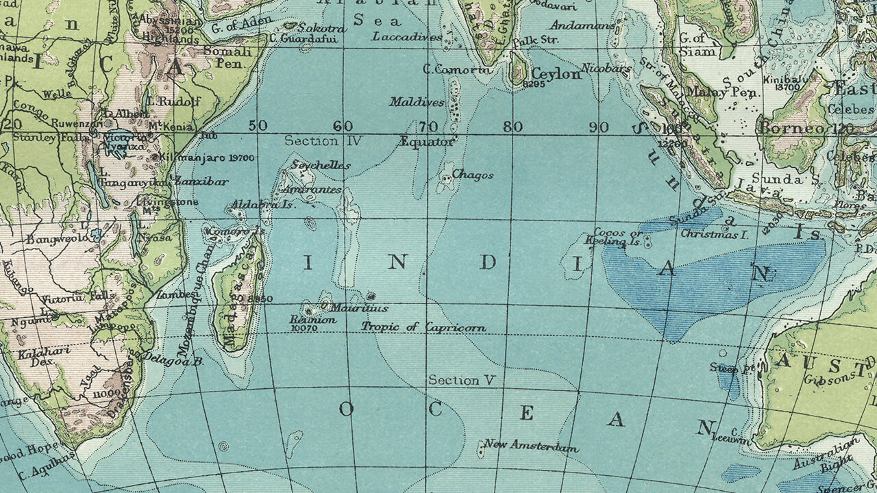
RELATION BETWEEN COMPANIES AND GROSS DOMESTIC PRODUCT IN SPAIN FROM 2008 TO 2017

Slide 2

Carlos Bayarri Cebrecos
Email: bayarricebrecos@hotmail.com
You can find me at https://github.com/CarlosBayarri
1

Slide 3
1. DESCRIPTION
Let’s start with the story

Slide 4
DESCRIPTION
OBJECTIVE
The purpose of this project is to collect, develop and analyze statistical data, and construct several suitable representations about this data, explaining a history, what is happened. We want to explain a little part of the business world in Spain along the crisis.
PROBLEMATIC SUCCESS
Spanish financial crisis (2008 – 2014)
1

Slide 5
2. FIRST STEP
How should we do it?

Slide 6
Steps for communicating map information
Consider what the real-world distribution of the phenomenon might look like
Determine the purpose of the map and its intended audience
Collect data appropriate for the map’s purpose
Design and construct the map
Determine whether users find the map useful and informative.
1

Slide 7
3. DATA
How should we do have?

Slide 8
STUDY ZONE
Our country
1

Slide 9
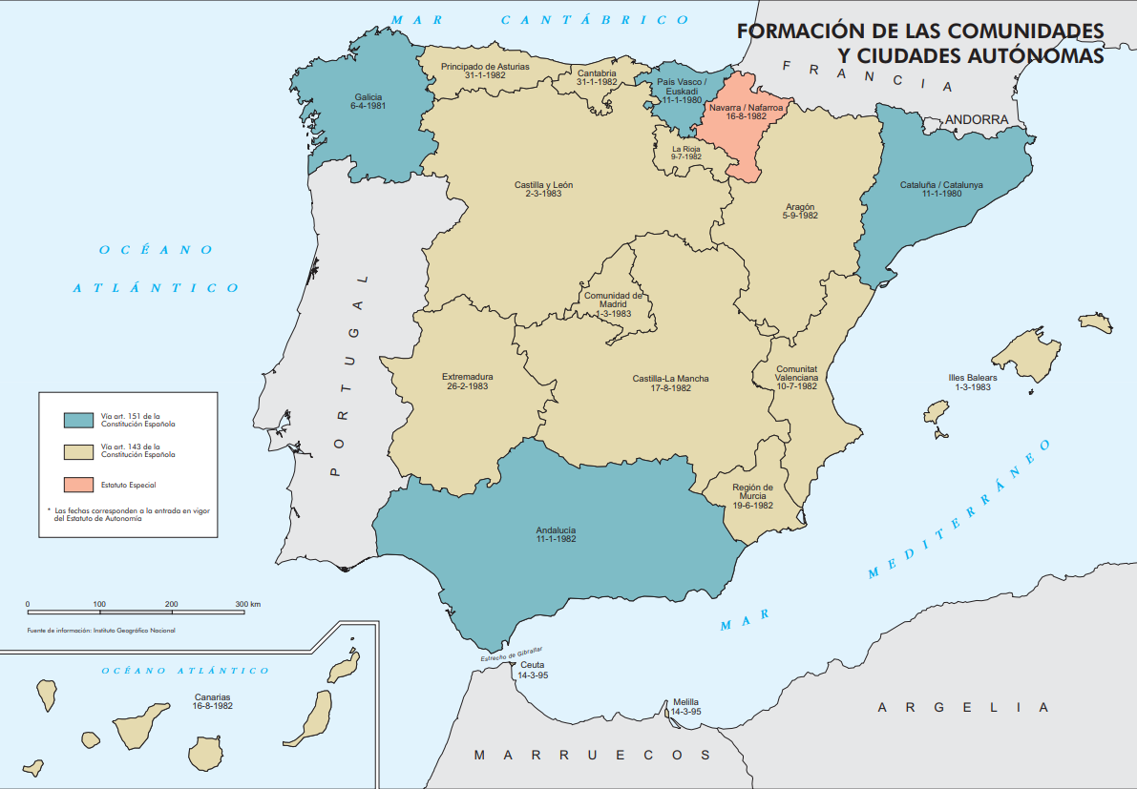
Regions
1

Slide 10
Lambert azimuthal
equal-area
projection
1

Slide 11
PROJECTION
Preserves the area of individual polygons while simultaneously maintaining a true sense of direction from the center.
The general pattern of distortion is radial
shape is minimally distorted, less than 2 per cent, angular
Distortion is more significant
Small shapes are compressed radially from the center and
elongated perpendicularly
Lambert azimuthal equal-area
projection
1

Slide 12
DATASETS
Companies by Region and main activity
Extractive industries
Building
Trade, transport and catering
Information and communication
Financial and insurance activities
Professional and administrative activities
House selling activities
Public administration and defense
Artistic activities
Gross Domestic Product per capita
It is a measure of a country's economic output that accounts for its number of people. It divides the country's gross domestic product by its total population.
That makes it the best measurement of a country's standard of living. It tells you how prosperous a country feels to each of its citizens.
Data source: Spanish Statistical Office
1

Slide 13
Companies
1

Slide 14
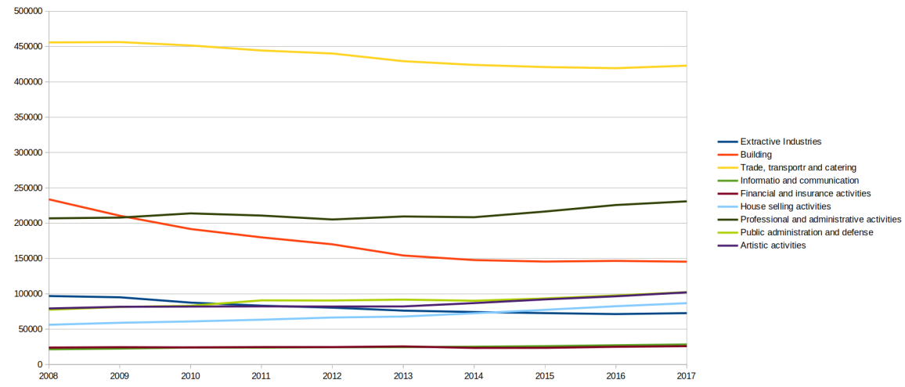
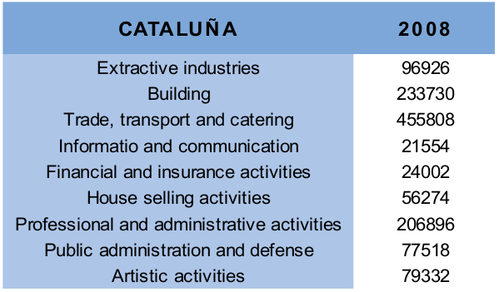
We can group them
1

Slide 15
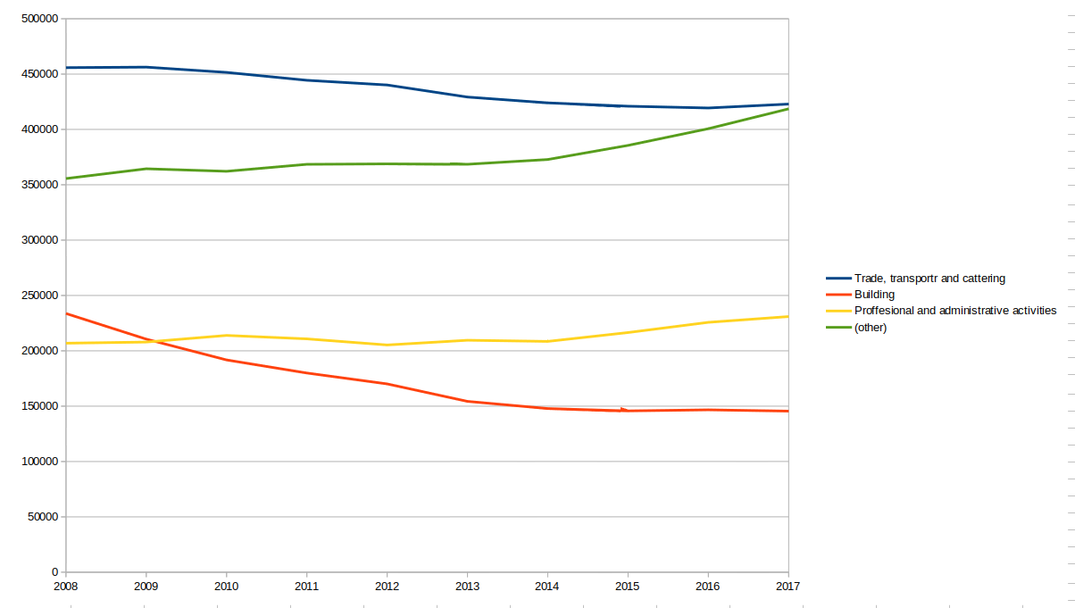
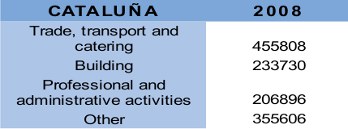
We can group them
1

Slide 16
REPRESENTATION METHODS
FOR STATIC MAP
Star or spider graph. The multivariate ray-glyph or star is constructed by extending rays from an interior circle, with the lengths of the rays made proportional to values associated to each variable.
FOR DYNAMIC MAP
Pie chart. These variables can be depicted using the pie chart, as a circle divided into sectors representing the proportion of each variable.
<number>

Slide 17
Gross Domestic Product
<number>

Slide 18
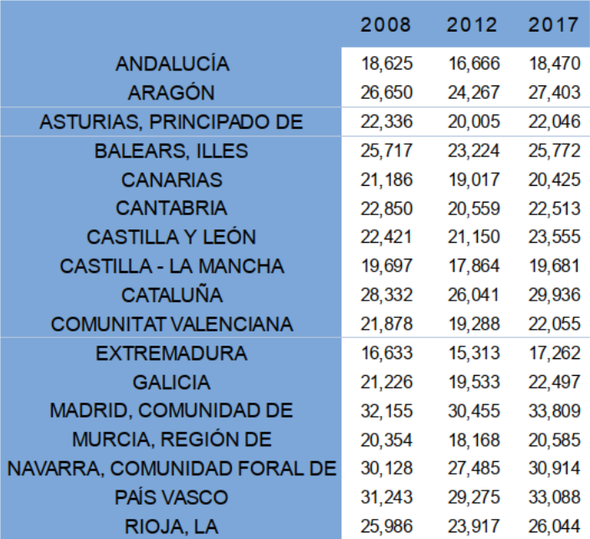
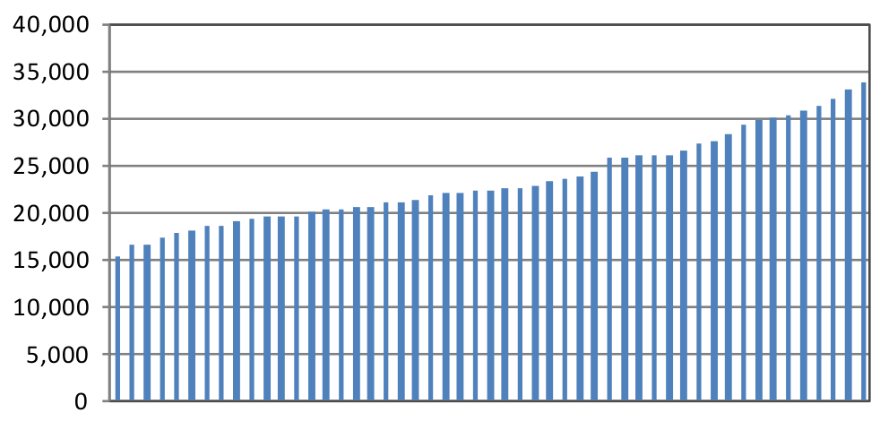
We can classify them
<number>

Slide 19
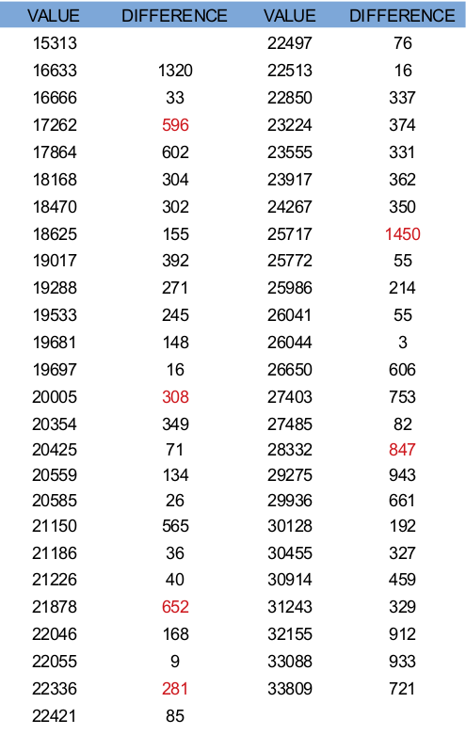
We can classify them
Minimum to 17000
17000 to 22000
22000 to 25000
25000 to 28000
28000 to maximum
<number>

Slide 20
REPRESENTATION METHODS
FOR STATIC MAP
Doughnut graph
(Pie graph with an area of the center cut out)
In this symbol we do not use proportional values.
FOR DYNAMIC MAP
Choropleth map.
Areas are shaded or patterned in proportion to the measurement of the statistical variable being displayed on the map.
<number>

Slide 21
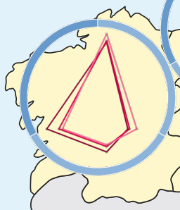
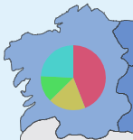
REPRESENTATION METHODS
FOR STATIC MAP
FOR DYNAMIC MAP
<number>

Slide 22
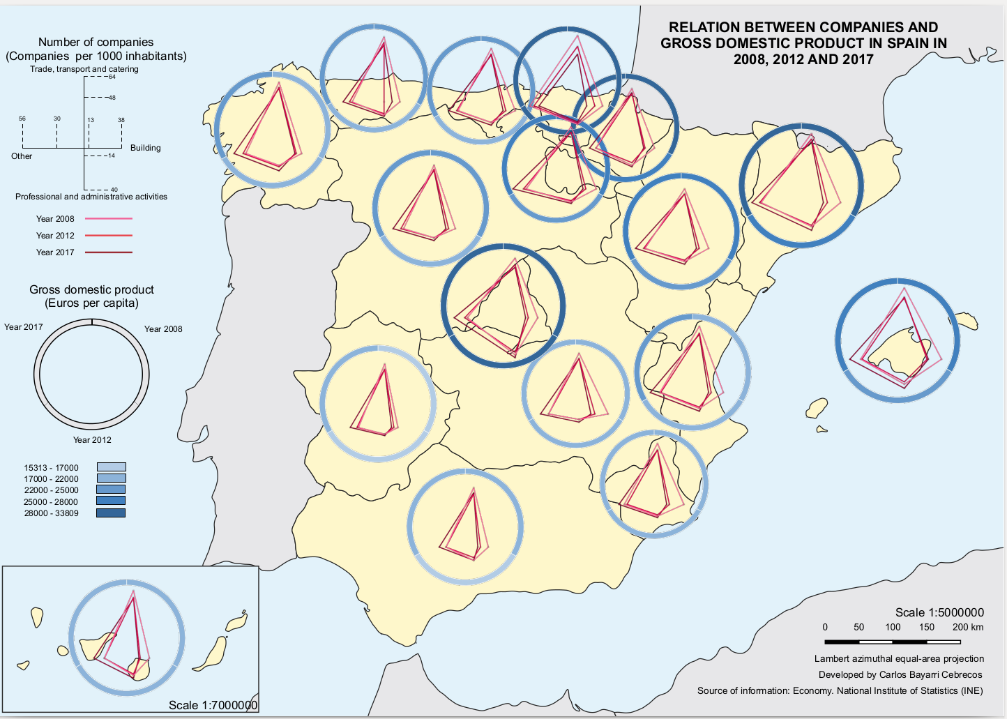
STATIC
MAP
<number>

Slide 23
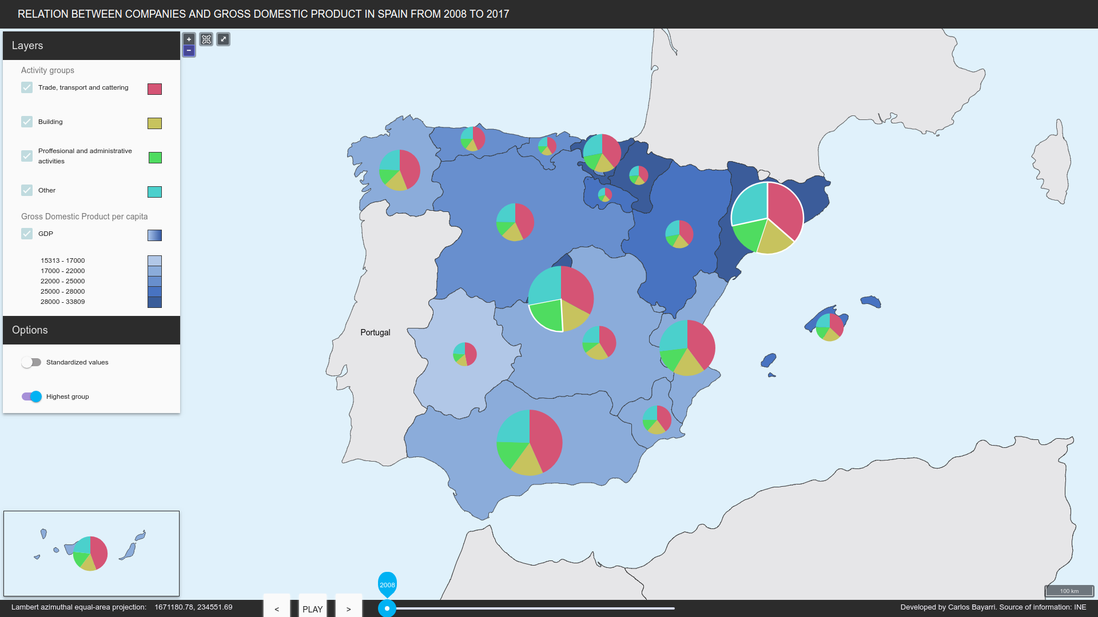
DYNAMIC
MAP
<number>

Slide 24
THANKS!
Any questions?
You can find me at https://github.com/CarlosBayarri & bayarricebrecos@hotmail.com
<number>

